Slide 1
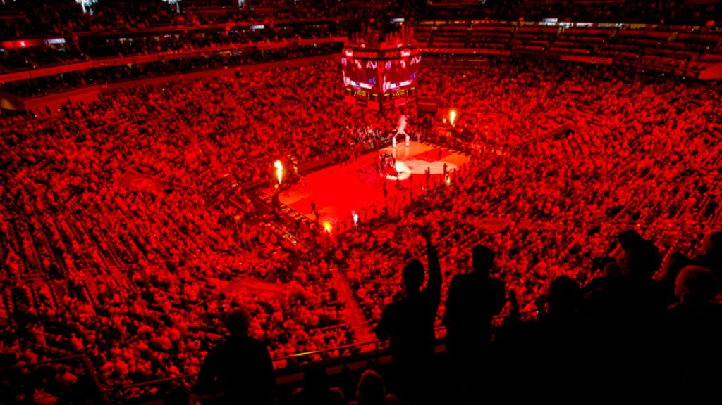
UNIVERSITY OF LOUISVILLE MEN’S BASKETBALL TEAM
Demo 1
MDKML

Slide 2
Overview Demo 1
Introduction
Demo
Conclusion

Slide 3
Introduction – Where We’re At:
BudiBase web application builder
Dev Database made with AirTable & Google Sheets (different for prod)
Secure sign on with Easy Onboarding
Account based site permissions

Slide 4
Introduction – What we’re working on:
Forms - Manual Data Entry
Player and page site stats
Comparison

Slide 5
DEMO

Slide 6
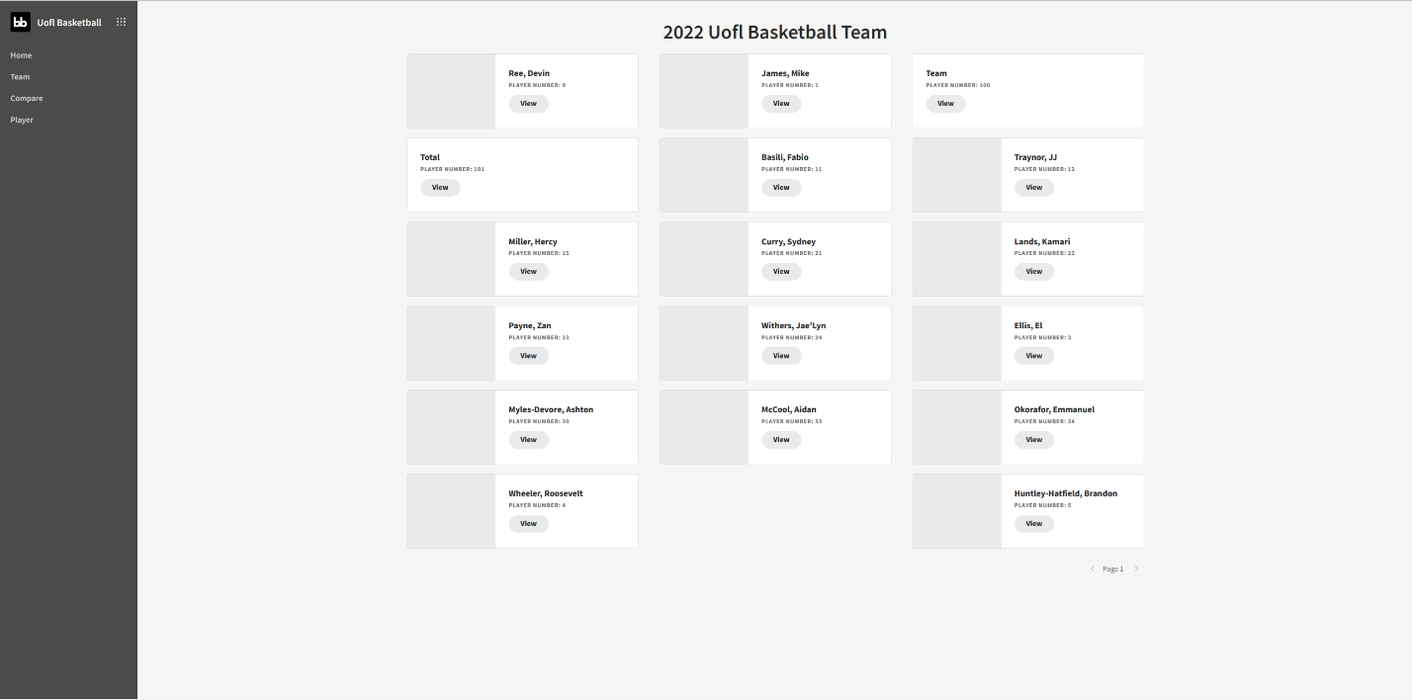
Backup Screenshots:

Slide 7
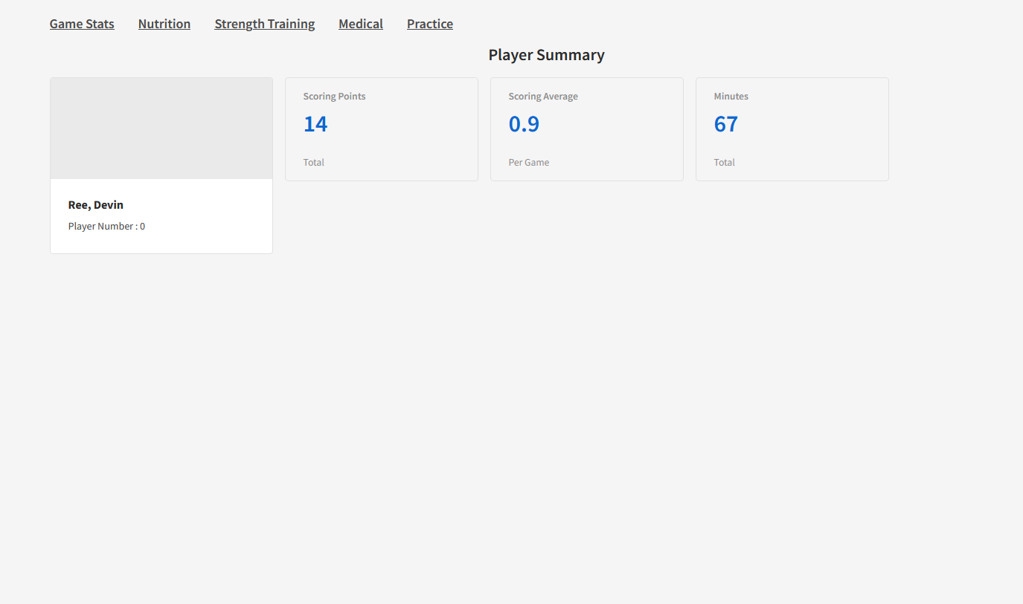
Backup Screenshots:

Slide 8
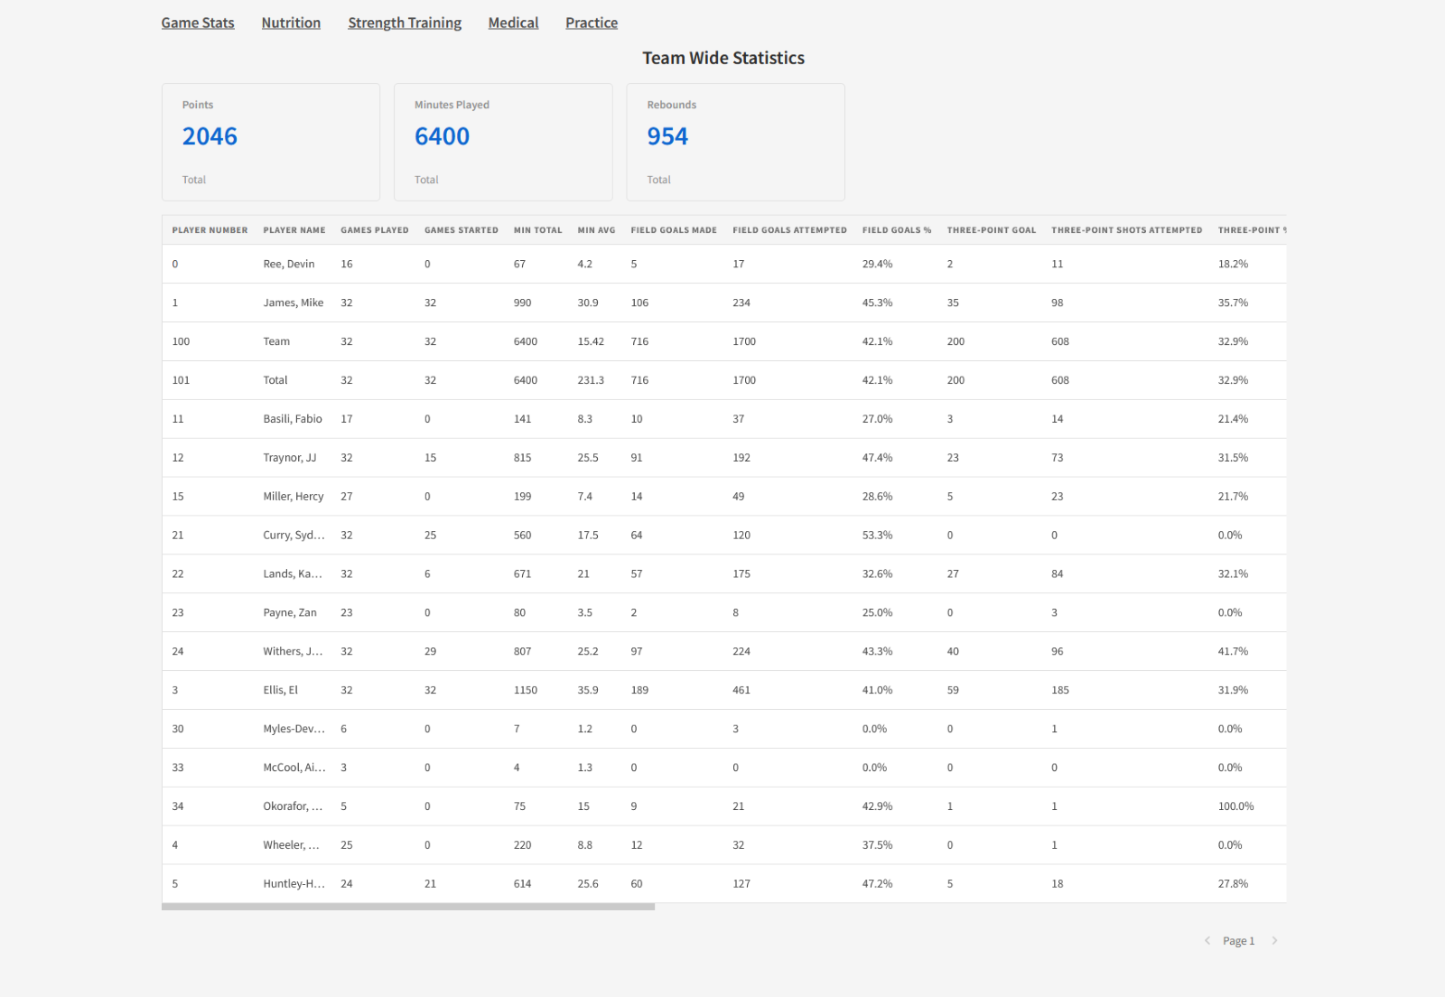
Backup Screenshots:

Slide 9
Conclusion Concluding Remarks
Data is integral to further design
What do you want to track?
What do you want to see on each dashboard?
Forms (Manual data Entry) Coming soon
Comparisons & Data visualizations

